Slide 1
Streamline Visualization of Cerebral Blood Flow
Created By:
Christian Rodriguez
Andrew Ding
Caleb Chau

Slide 2
Abstract
Proposition: use image processing and pattern recognition in order to visualize blood flow in the brain using digital subtraction angiography.
In order to achieve our goal, we use vector fields, streamlines, and flow visualization.
This will help doctors visualize and diagnose abnormalities in key areas of the brain.
Chronological set of DSA images → median filter on DSA images → vector field
The vector field is key in creating the animated flow of the blood in the vessels.

Slide 3
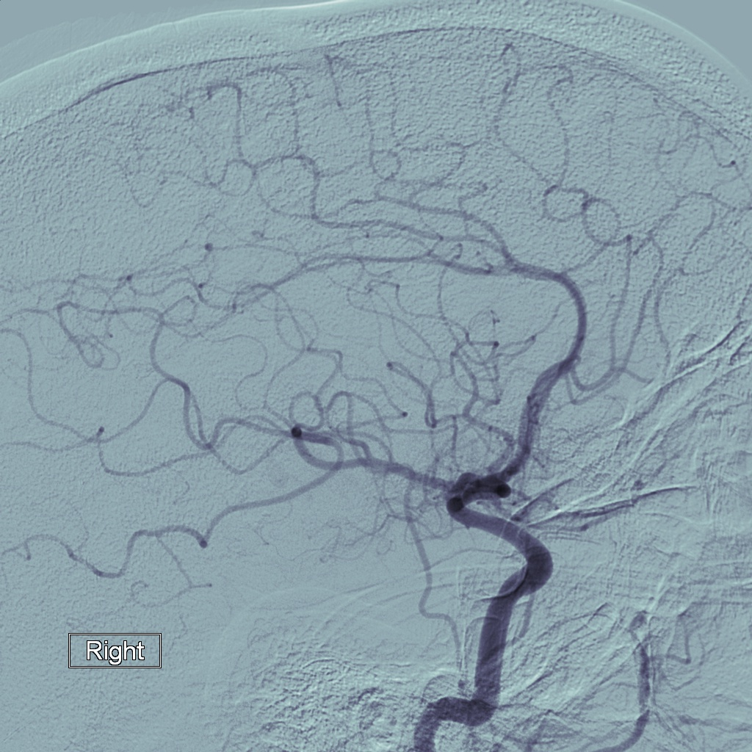
Digital Subtraction Angiography
What is digital subtraction angiography?
A technique used in radiology to clearly visualize blood vessels in bony or dense tissue environment.
Images are produced using a contrast medium by subtracting a mask from subsequent x-ray images.
This means that the images with the dye is subtracted from the main x-ray image. The many mask images are subtracted over time in order to produce a clear view of the blood vessels.
Figure A:
Patient DSA Image

Slide 4

Introduction
Goal: apply image processing and use vector fields in order to create animated cerebral blood flow.
In order to do this our team needs to do 4 main things:
Preprocess the image to decrease noise in image.
Identify vessels through the help of the Frangi filter.
Create the vector field.
Generate streamlines that generate the blood flow animation.
There are almost 500,000 deaths worldwide each year related to problems with cerebral blood flow.
Most complications with cerebral blood flow are found by chance when patients come in to complain about unrelated symptoms.

Slide 5
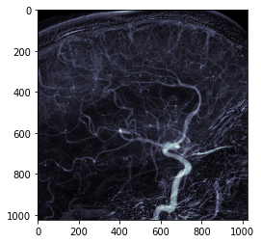
Methodology
Preprocessing
Filters and morphology are applied to each of the 20 images in order to decrease noise.
We mainly used a median filter:
Assigns the value of a pixel to the median of a 15x15 pixel window.
Planned to use a gaussian filter but since the median filter is non-linear and preserves edges, it produced a better result.
A closing operation is used in order to reduce the ‘pepper noise’ in the image.
This helps identify blood vessels in a much easier fashion.
Figure B:
Median Filter applied on DSA image

Slide 6
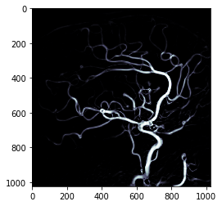
Methodology
Identifying Blood Vessels
Came with a really big challenge of misidentification.
As time progresses, main blood vessels stem into smaller ones and the dye in the picture reduces in intensity.
We mainly used a Frangi filter:
Uses eigenvalues of the Hessian in order to detect continuous edges.
Dynamic thresholding is used in order to easily process the image.
In the binary image, a white pixel represents a point part of a vessel.
Figure C:
Frangi Filter applied on DSA image

Slide 7
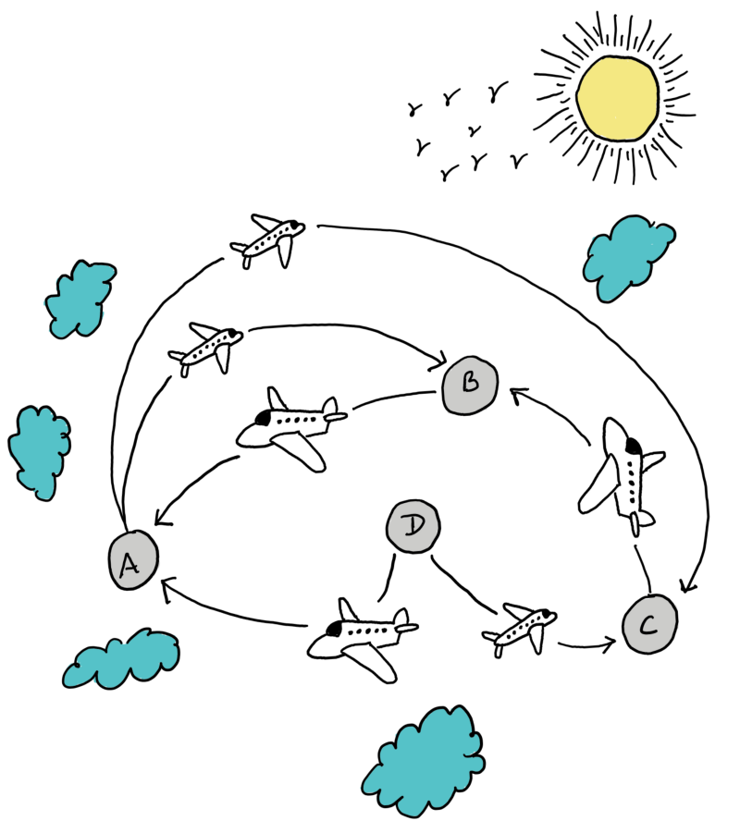
Methodology
Creating Vector Fields
Direction of blood flow generated through comparisons of subsequent DSA images.
Skeletonize the binary vessel images for easier identification.
Comparison of updated pixel location with previous location generates direction of blood flow.
Use of BFS algorithm in order to connect segments and assign direction to the next pixel.
If vector field at a point (x, y) in the skeleton is pointing (0, 1) the same vector field can be applied to points along the same vessel with the same y image.
Figure D:
Simple BFS diagram

Slide 8
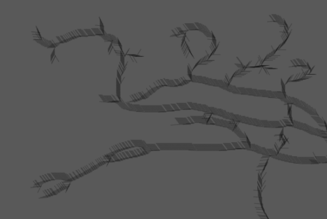

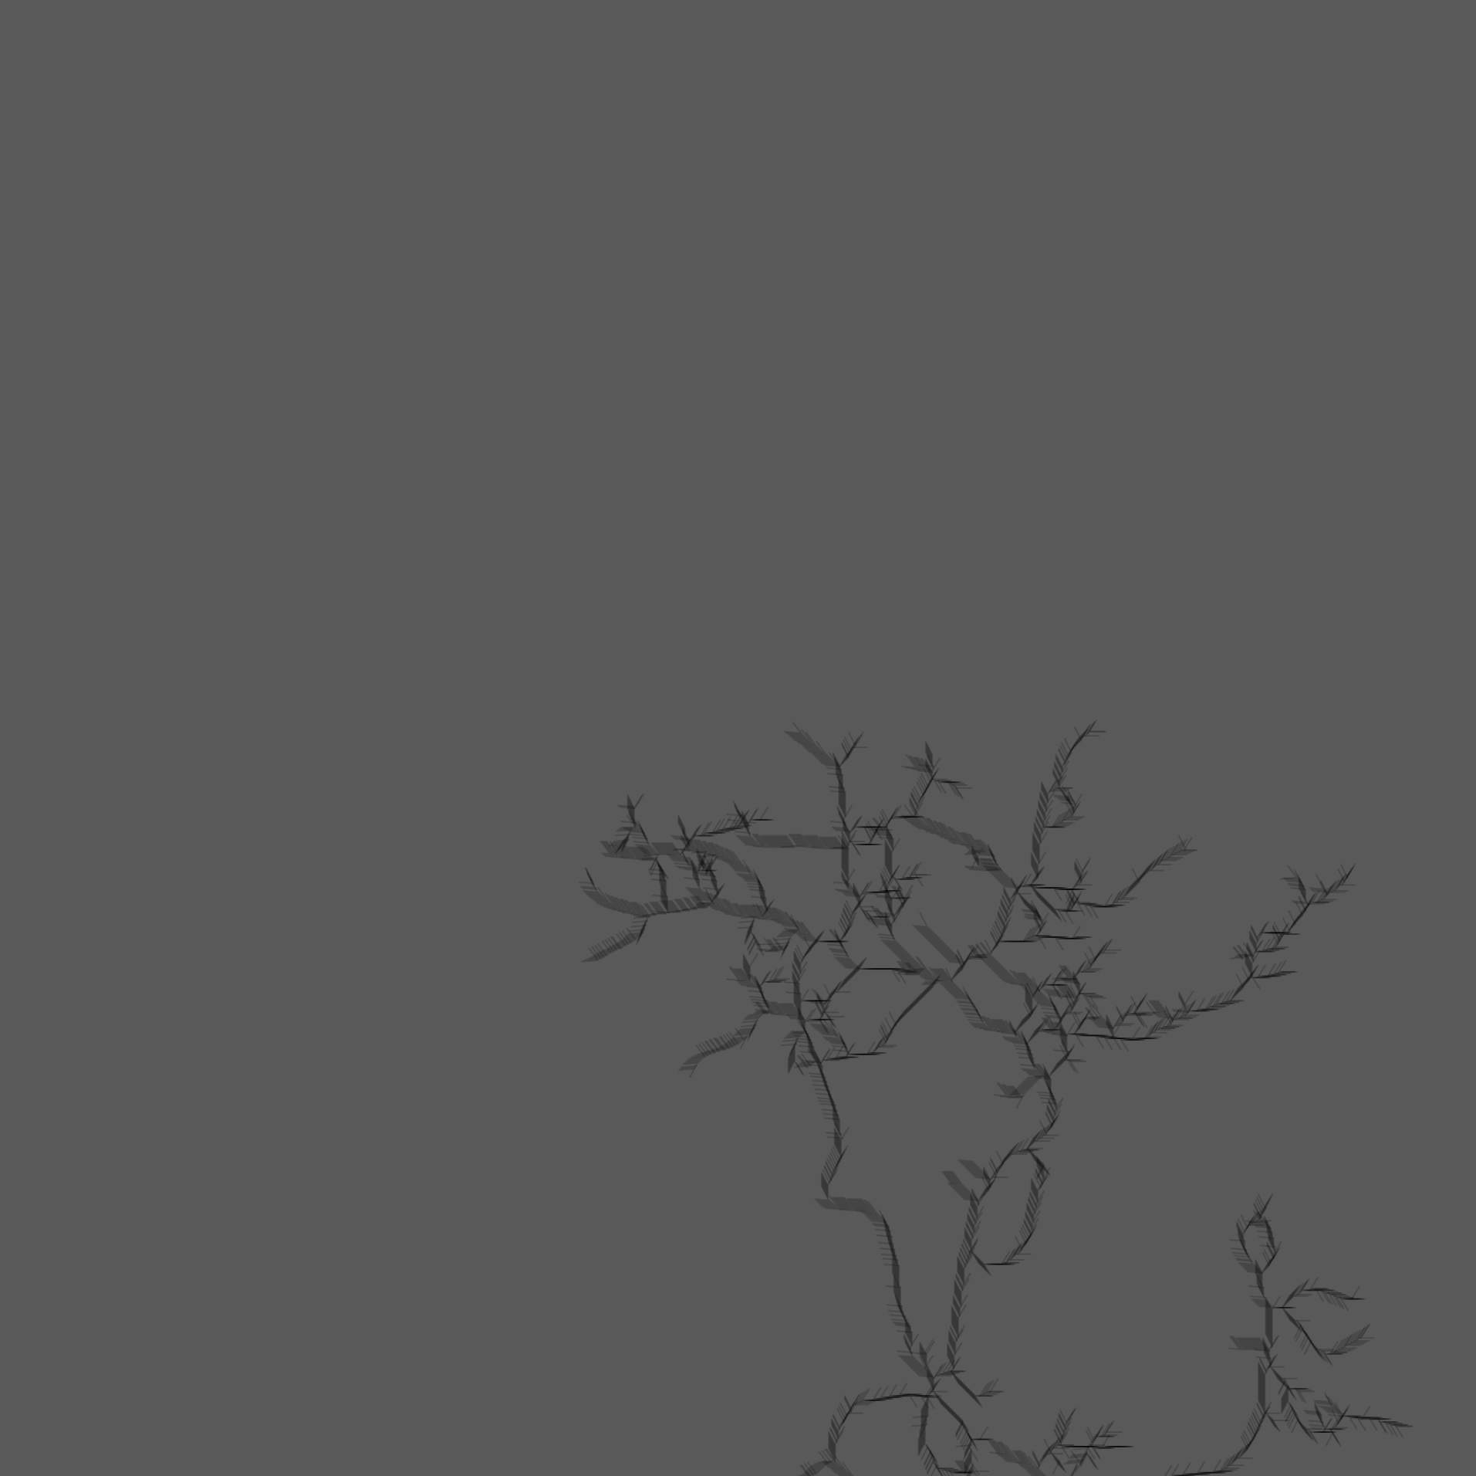
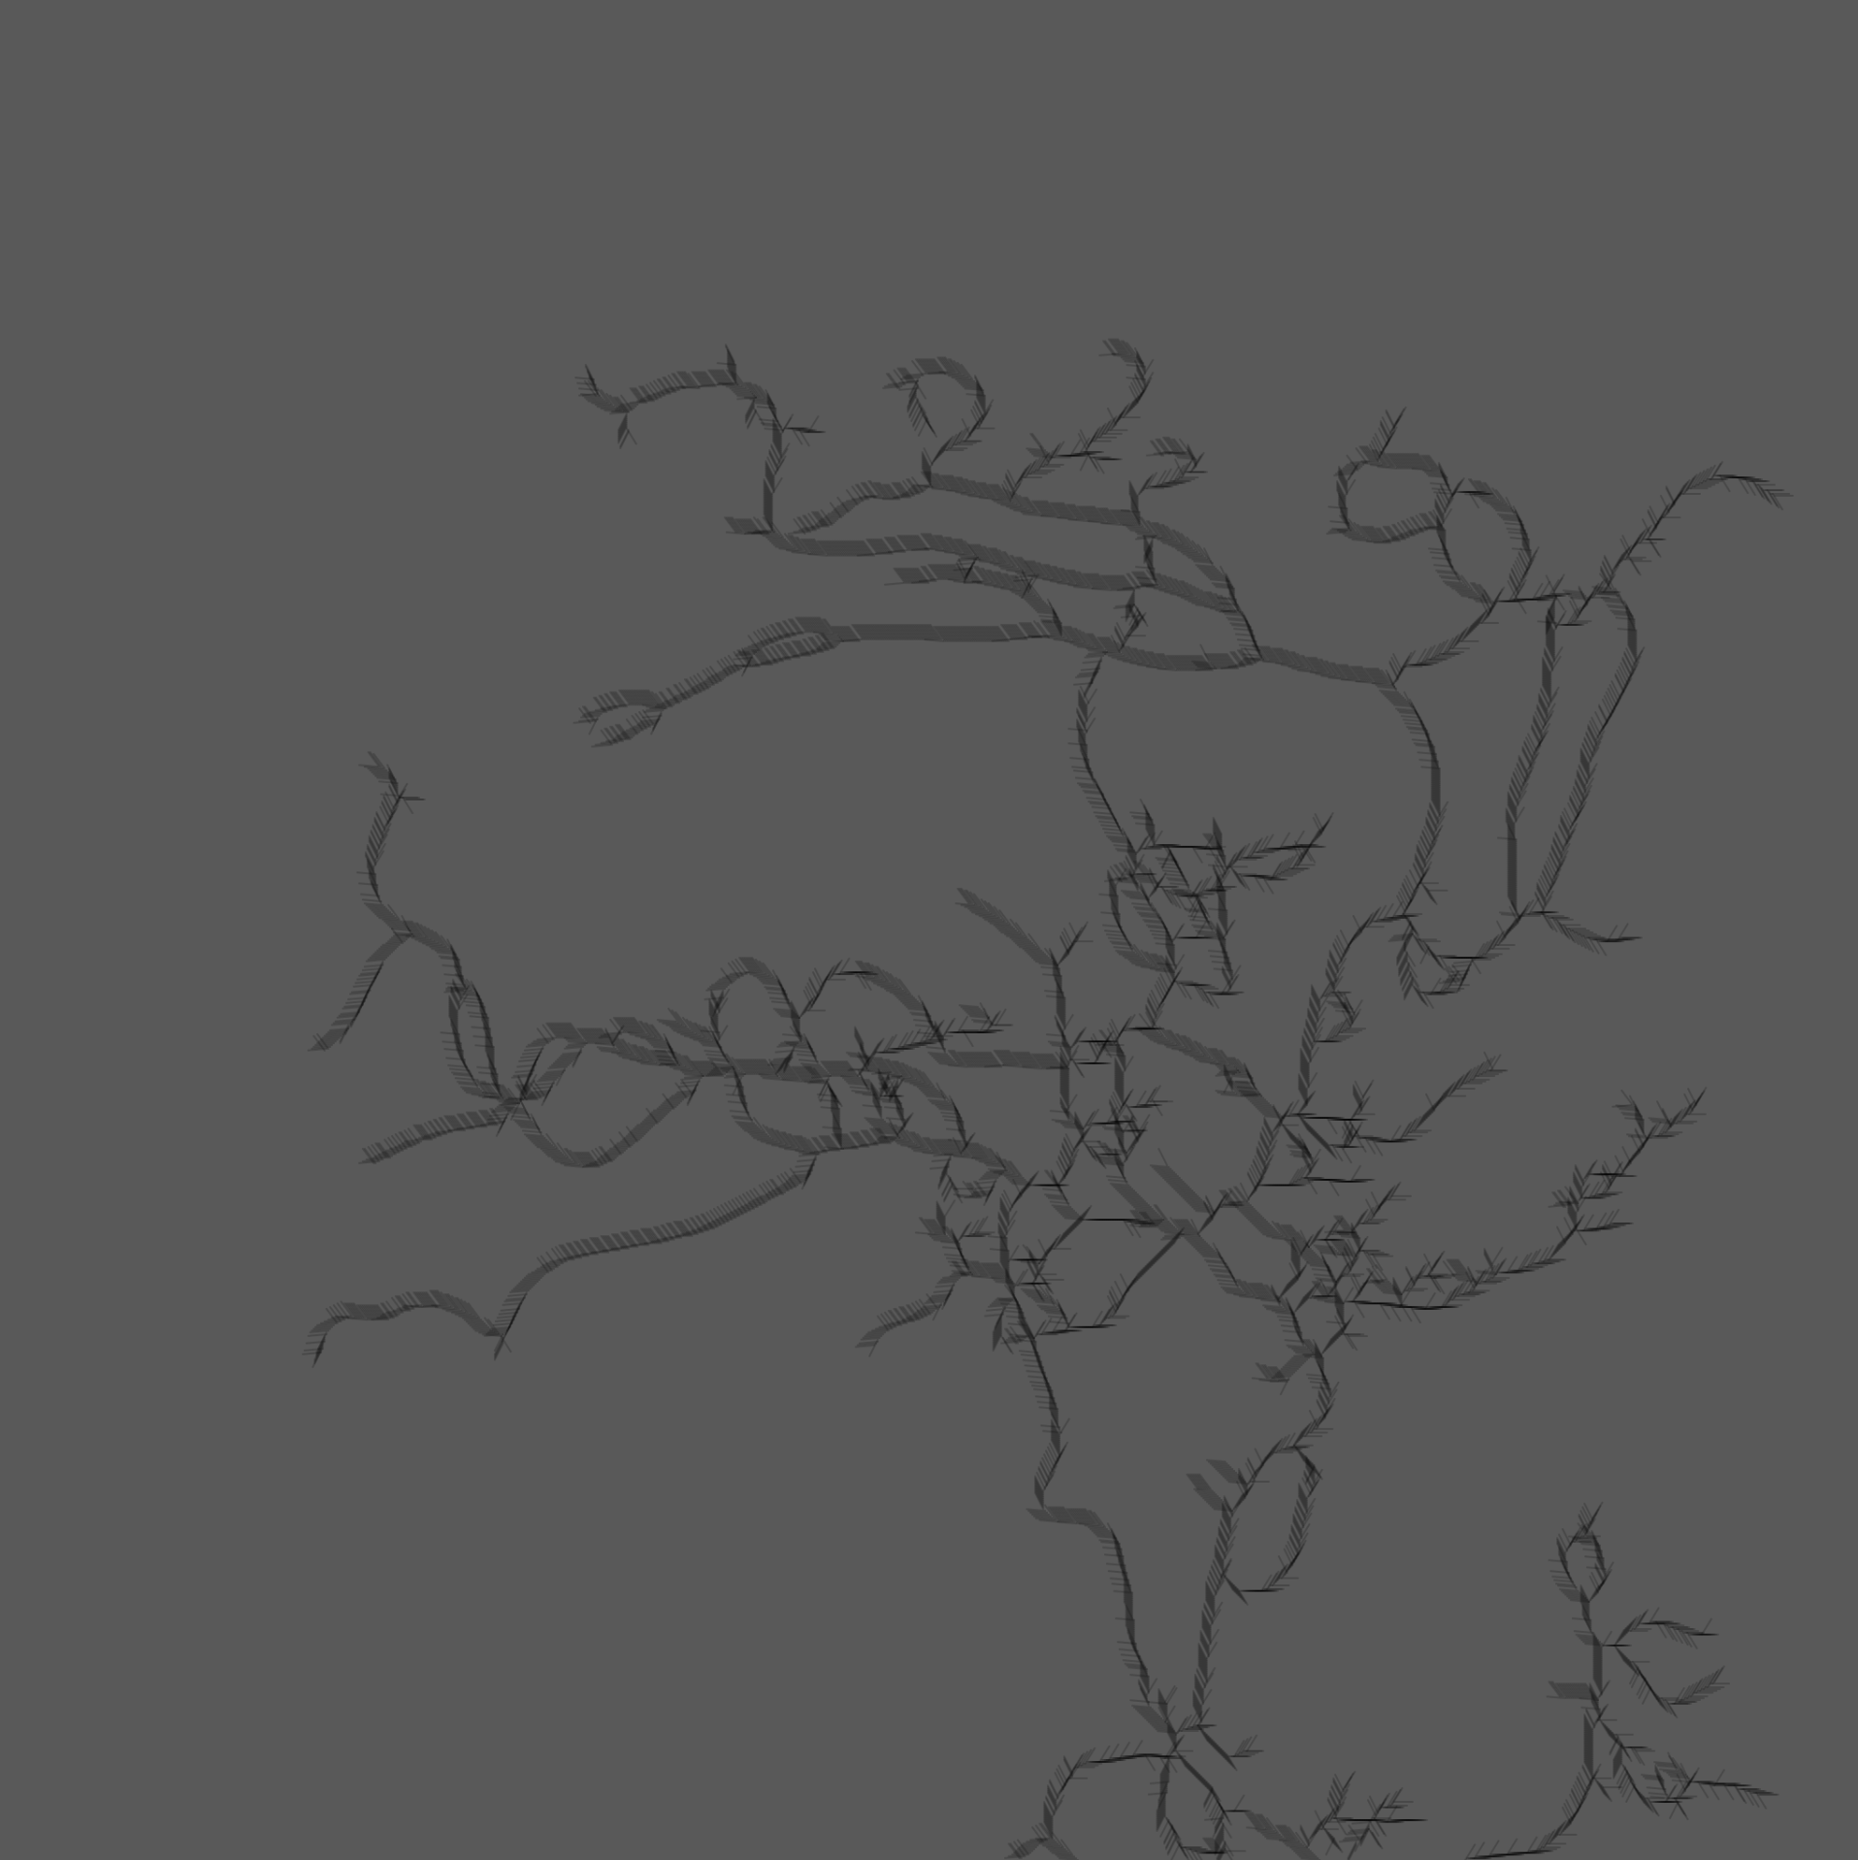
Rendering Vector Fields
Rendering Vector Fields
HTML, CSS, and JavaScript (P5 Library)
CSV data → images → generate a gif for background → put vector field on top of gif → apply points to the vector field
Figure F: Zoomed Vector Lines
Figure E:
Vector Field
Generation

Slide 9
Evaluation
Blood Flow Direction Identification
Complicated problem with given data
Since images are 2D, some vessels appear to be branching off each other in the image.
However, one vessel could actually be passing behind another in the z-axis.
Rendering
Troublesome task when outputting to webpage
Lining up several layers of data (gif, vector field, points) took a long time
Could have used a physics engine in order to display points of blood flow but if the flow was not constant, the rendering would be incorrect.

Slide 10
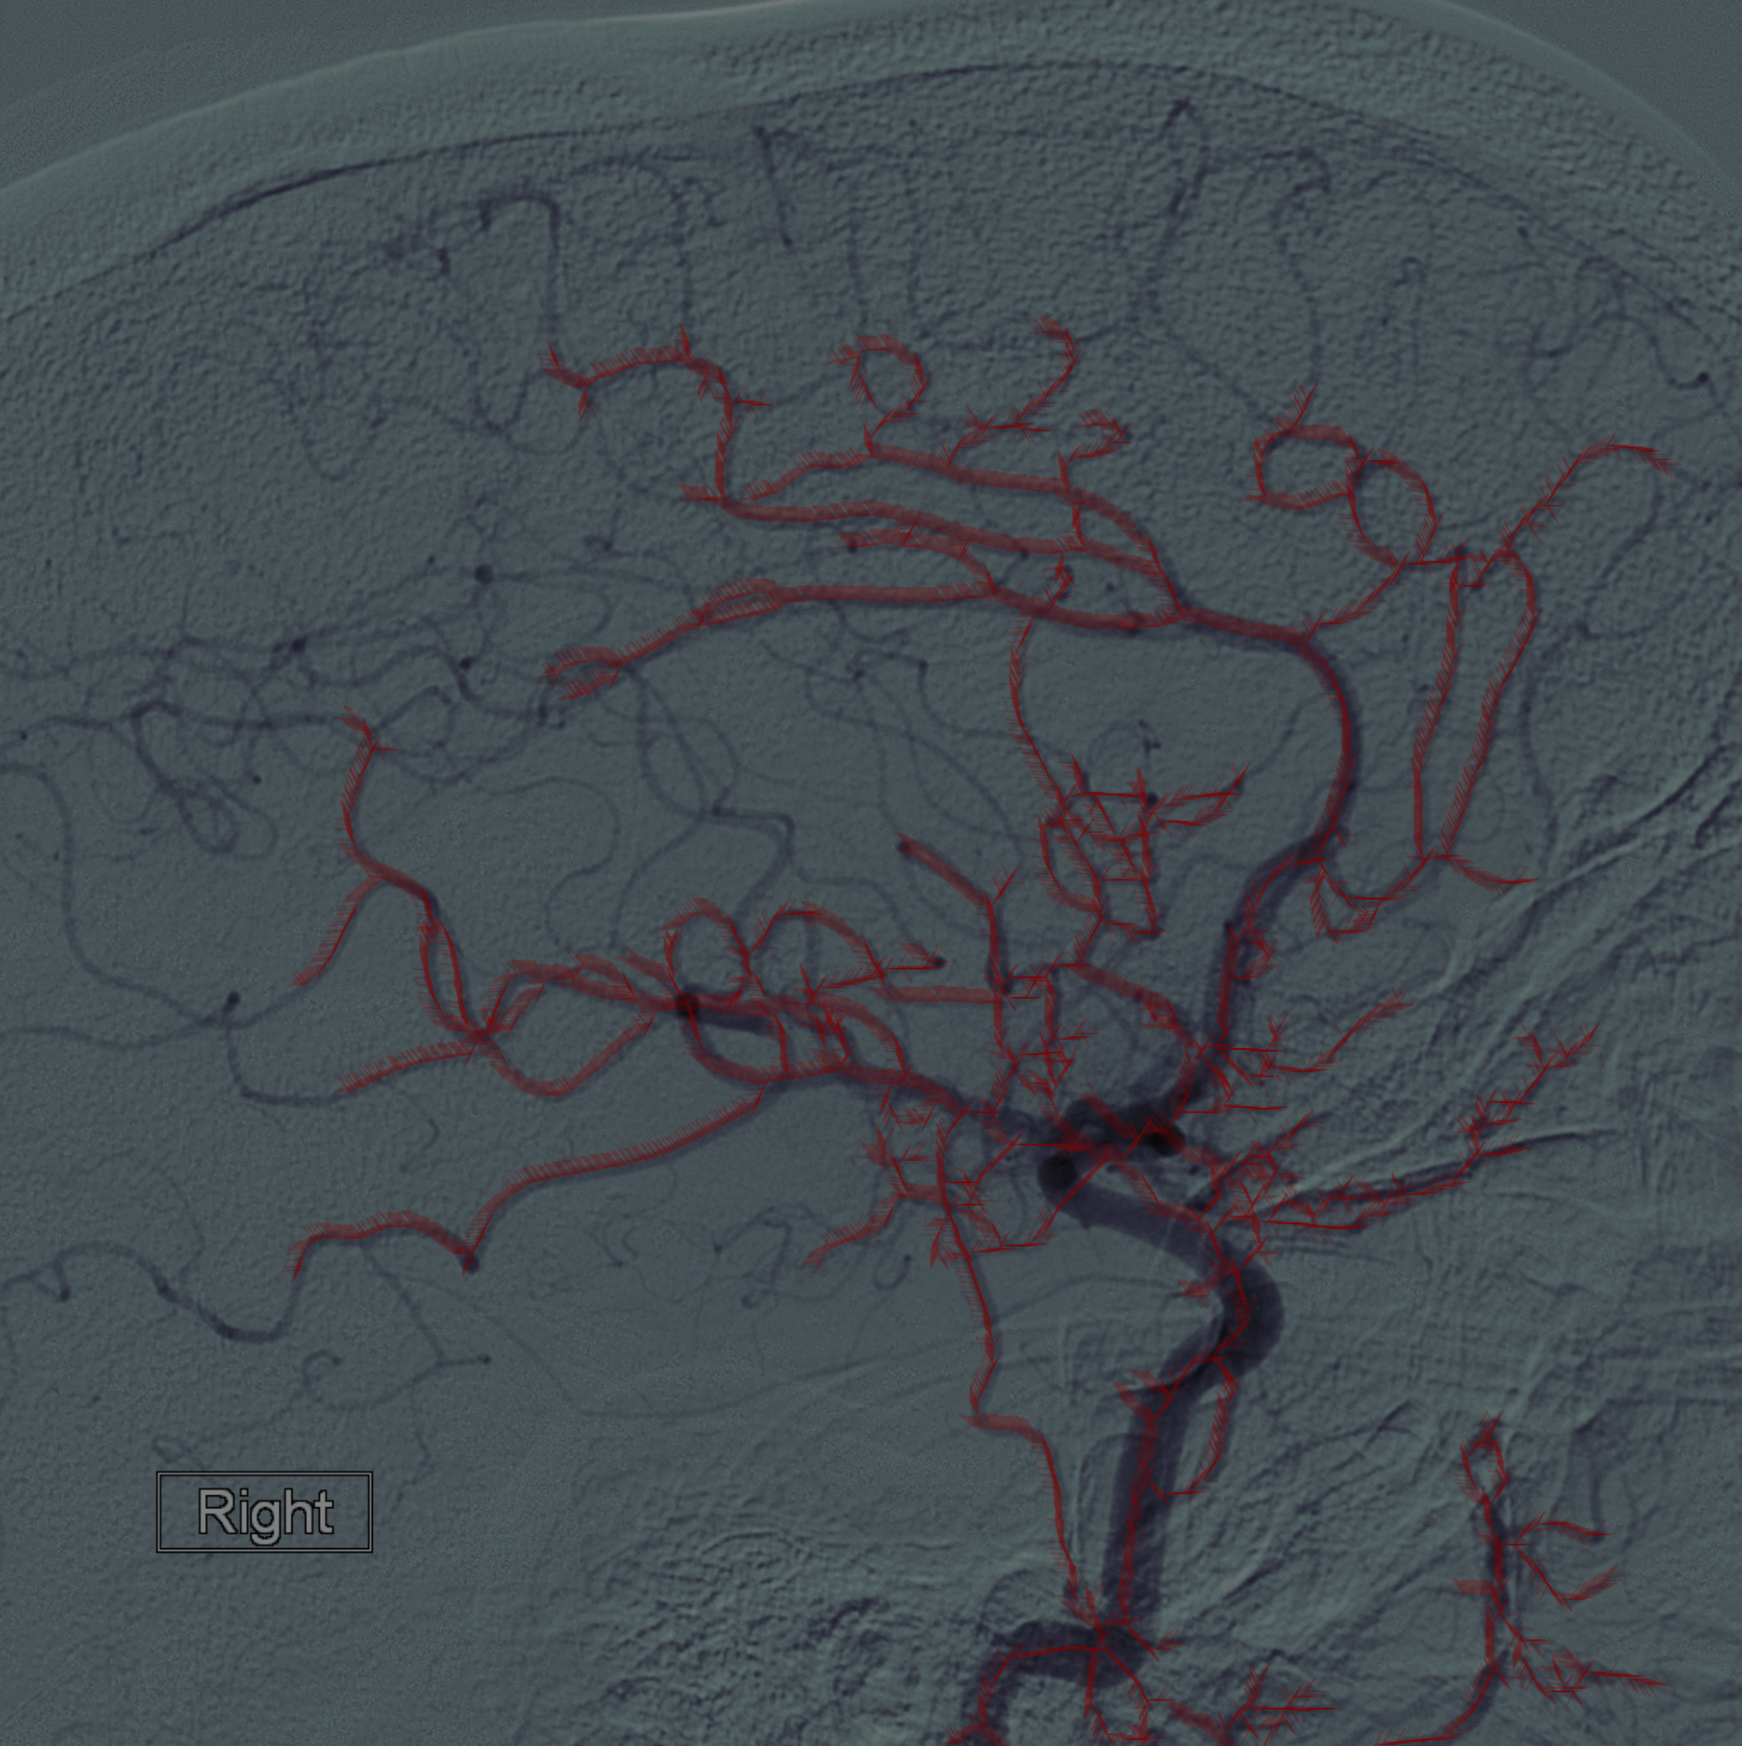
Results
The results of our project can be seen in Figure H.
The vector field is rendered transparently which allows us to generate visible particles that follow the “invisible field.”
The alpha (opacity) of the particles are lowered over time and new particles are generated in order to better visualize the blood flow.
In addition, when you hover over the image, the original angiography can be seen in order to compare it with the blood flow.
Figure H:
Final Result of Render

Slide 11
Discussion
Opting out of using Difference-of-Gaussians (DoG)
Our final implementation for our blood flow algorithm did not use DoG because the use of a median filter better suited our needs.
Median filter preserved edges better and was a linear filter, unlike DoG.
JavaScript P5 Library
The P5 Library allowed us to visualize and render vector fields in a neat fashion
P5 is not the best performing visualization tool and tends to slow down as more particles are generated
In the future, we can use Processing, a visualization framework uses OpenGL, which would allow for smoother and more efficient animations.
Future implementations
Implement rigorous machine learning algorithms in order to generate the vector fields

